Slide 1
Admin:
Cancel a reservation

Slide 2
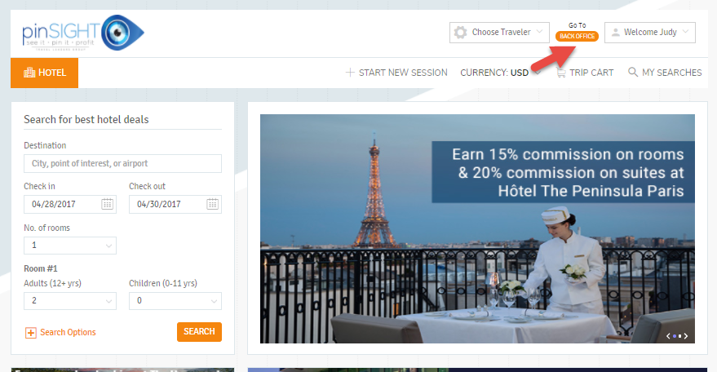
Log in to pinSIGHT and click on Go To BACK OFFICE

Slide 3
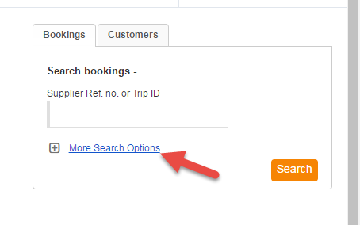
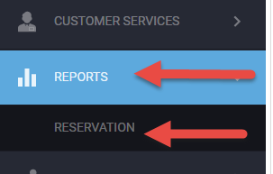
There are 2 ways to search for your bookings:
Use the home page Bookings search or navigate to Reservations -> Reports

Slide 4
When the reservation report appears click on the Trip ID # to view the Trip Folder

Slide 5
From the Trip Folder click on the Process Bookings tab:
Under the Process Bookings tab click Cancel Booking

Slide 6
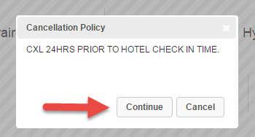
When you click to cancel a box will pop up with the cancellation policy:
Click Continue to cancel the booking or Cancel if you do not wish to proceed.

Slide 7
After clicking Continue when canceling
A message will appear that the booking has been cancelled successfully and the status on the booking will change to canceled
.

